Slide 1

Financial Accounting
Dr.Smita Jape
Associate Professor
DR.V.N.BRIMS

Slide 2
Fund Flow statement Chapter 8

Slide 3
What is Fund Flow Statement?
Fund flow statement is a statement that compares the two balance sheets by analyzing the sources of funds (debt and equity capital) and the application of funds (assets) and its reasons for any differences. It helps the company see through where their money has been spent and from where they have received the money (long-term funds raised by issues of shares, debentures, and sale of non-current assets).

Slide 4
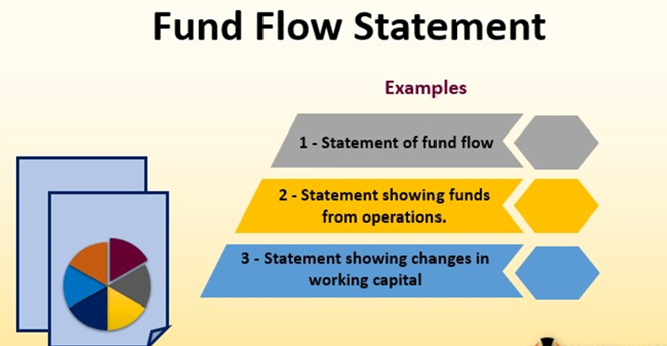
Fund Flow Statement

Slide 5
Fund Flow Statement
It has three separate statements –
Statement showing changes in working capital.
Funds from operations.
Statement of fund flow.
#1 – Statement showing changes in working capital
In this statement, you need to effect the changes in working capital. Working capital equals current assets minus current liabilities. We will see the format and example of how it is done.

Slide 6
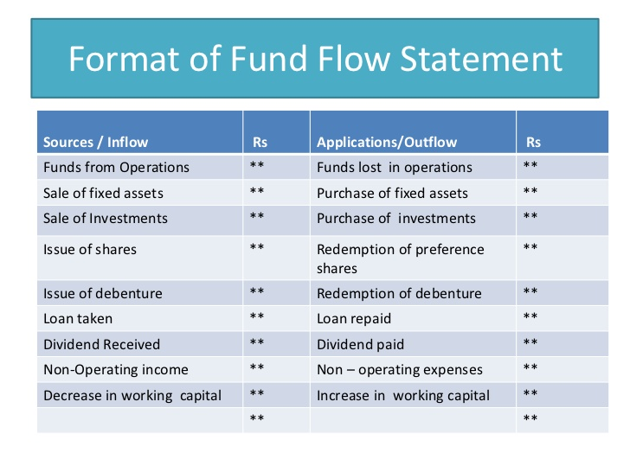
Fund Flow Statement

Slide 7
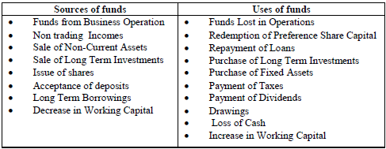
Fund Flow Statement

Slide 8
#2 – Statement showing funds from operations
Particulars | 31.03.2015 (in US $) | 31.03.2016 (in US $) | Increase (in US $) | Decrease (in US $)
Current Assets –
Inventories | 120,000 | 150,000 | 30,000 | –
Accounts Receivable | 110,000 | 70,000 | – | 40,000
Cash & Bank | 65,000 | 80,000 | 15,000 | –
Bills Receivable | 46,000 | 32,000 | – | 14,000
Prepaid expenses | 13,000 | 16,000 | 3,000 | –
Total Current Assets (A) | 354,000 | 348,000
Current Liabilities –
Accounts Payable | 45,000 | 60,000 | – | 15,000
Bills Payable | 30,000 | 25,000 | 5,000 | –
Outstanding expenses | 11,000 | 12,000 | – | 1,000
Total Current Liabilities (B) | 86,000 | 97,000
Net Working Capital (A – B) | 268,000 | 251,000
Net Decrease in Working Capital | – | 17,000 | 17,000 | –
Total | 268,000 | 268,000 | 70,000 | 70,000

Slide 9
Statement of Fund Flow at the year ended 31st March 2016
Particulars | Amount (in US$) | Amount (in US$)
Sources of Funds
Funds from operation (ref: the second statement) | 198,000
Sale of Fixed Assets | 50,000
Issue of new shares for preference shareholders | 100,000
Total Sources (A) |  | 348,000
Applications of Funds
Purchase of Plant | 108,000
Purchase of Buildings | 42,000
Payment of taxes | 100,000
Payment of dividend | 65,000
Redemption of Preference Shares | 50,000
Total Application (B) |  | 365,000
Net Decrease in Working Capital (A – B) |  | 17,000

Slide 10
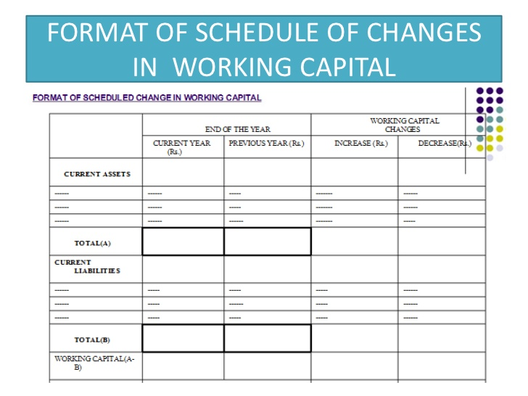
Schedule of Changes in Working Capital
Working Capital = CA –CL

Slide 11
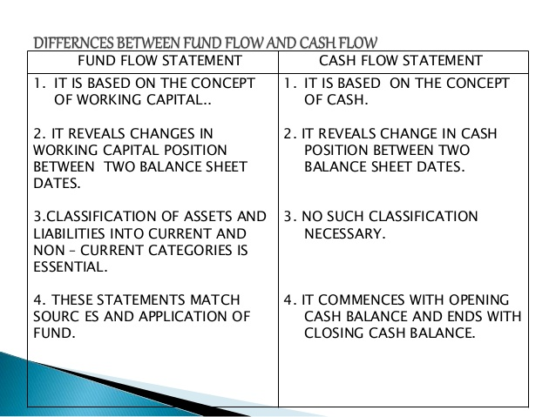
Difference between cash flow and fund flow statement

Slide 12
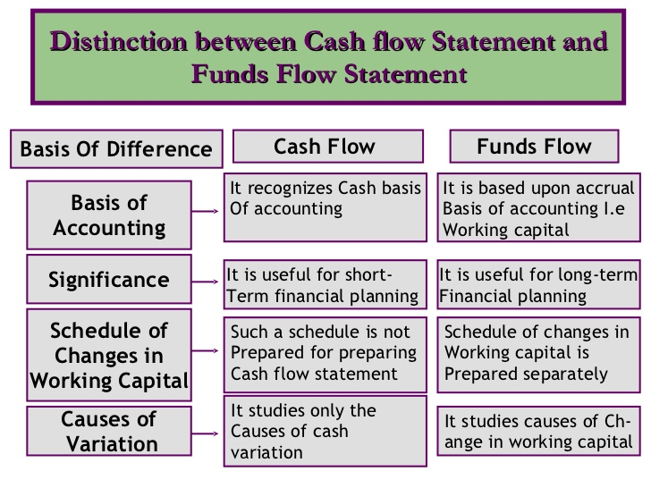
Difference between cash flow and fund flow statement

Slide 13
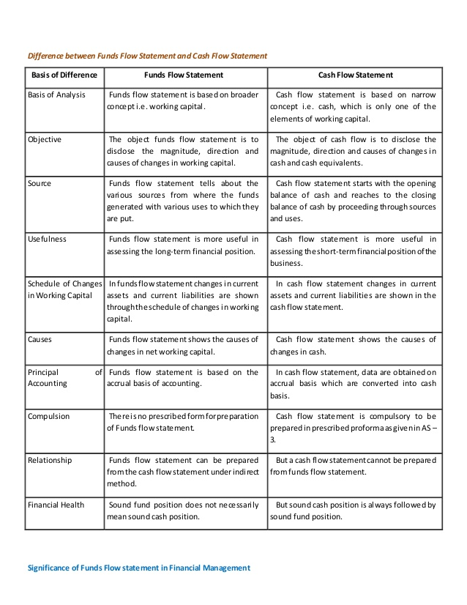

Slide 14
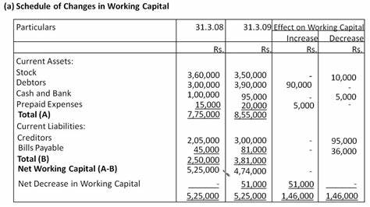
Schedule of Changes in working Capital

Slide 15
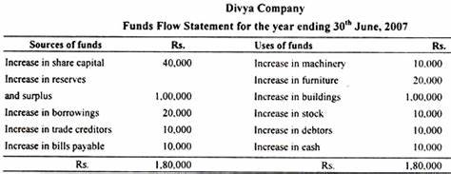
Schedule of Changes in working Capital

Slide 16
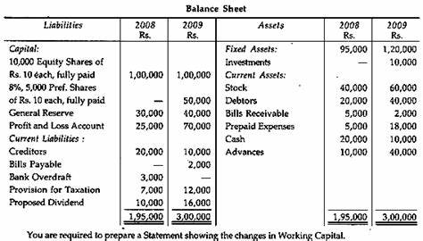
Schedule of changes in working capital

Slide 17
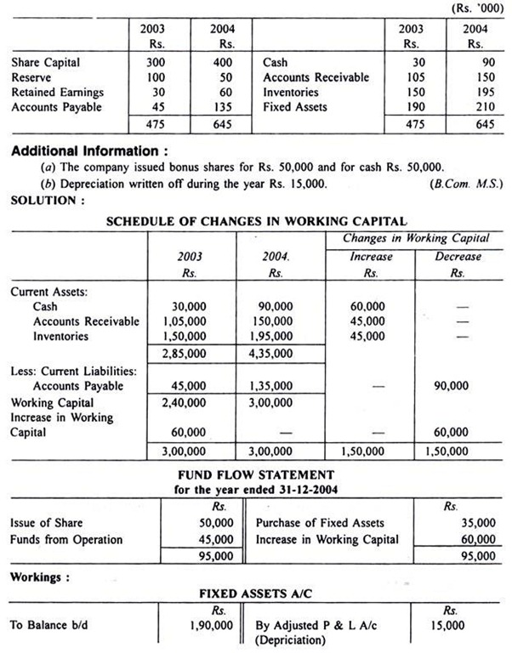
Fund flow statement
From the following information relating to A Ltd., prepare Funds Flow Statement:

Slide 18
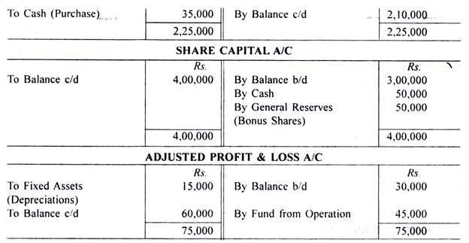
Continued

Slide 19
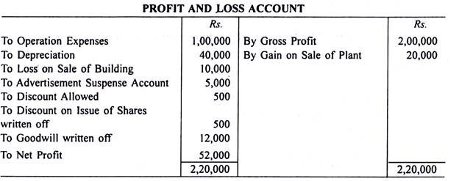
Solution:
Ramco Cements presents the following information and you are required to calculate funds from operations:

Slide 20
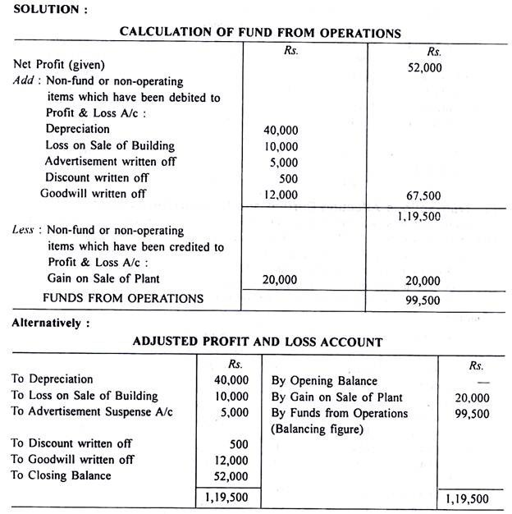

Slide 21
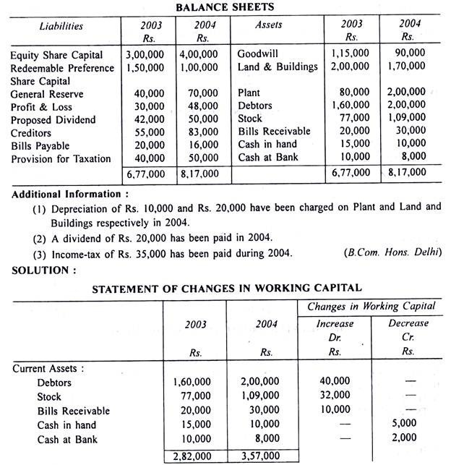
From the following Balance Sheets of X Ltd. make out:
(i) Statement of Changes in Working Capital
(ii) Fund Flow Statement:

Slide 22
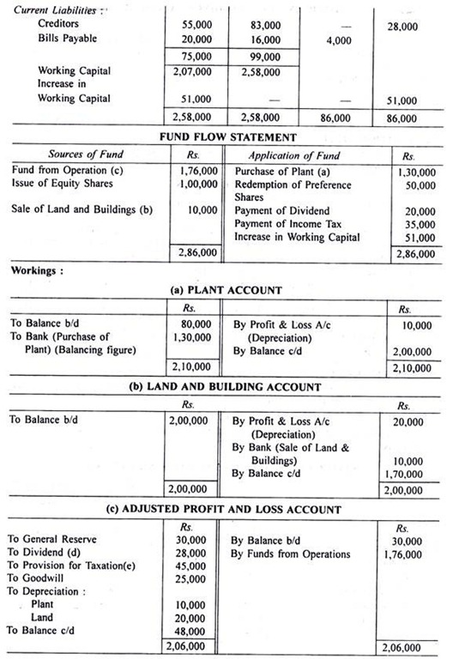

Slide 23
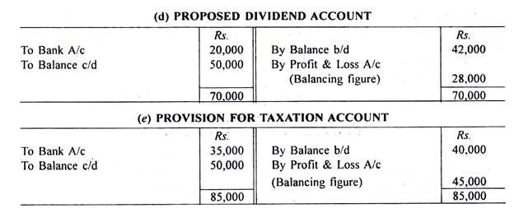
Continued

